Slide 1
Formulation and solution technique for agricultural waste collection and transport network design
, , ,
, , ,
, , ,
Trung Hieu Tran, Thu Ba T. Nguyen, Hoa Sen T. Le, Duc Chinh Phung
DSSC Master’s student Pietro Morichetti

Slide 2
Chapters
01
02
03
04
Problem Intro
Modelling
Agricultural waste mis-management
Location-Assignment-Routing-Problem
Water Flow Algorithm
Case studies &
Scalability analysis
A meta-heuristic improvement
LARP optimal solution

Slide 3
01
Problem Introduction
Agricultural waste management

Slide 4
In developing countries, agricultural sectors have rapidly developednto become major contributions in the economy.
Agricultural waste management has posed a challange for rural planner due to lack of efficient planning tool.
Burning the agricultural waste at fields after each harvesting season is the present solution, this caused air and water pollution in rural areas.

Slide 5
Agricultural waste around the world for developing countries
source: International Journal of Environmental Research and Public Health

Slide 6
45,22 million tons
10 millions tons
6,33 millions tons
Vietnam
2019
Rice straw
Vegetable by-products
Maize by-products
…
source: Ministry of Agriculture and Rural Development of Vietnam

Slide 7


An efficient way to recover agricultural waste

Slide 8
02
Modelling
Location-Assignment-Routing-Problem

Slide 9
Logistic problem
A possible scenario
Which and how many places should be chosen where storages should be built to ensure coverage over all cultivation fields?
Location Assignment Problem
Which roads should trucks take to visit all the storages and bring agricultural waste to the fertiliser factory?
Another possible scenario
Routing Problem

Slide 10
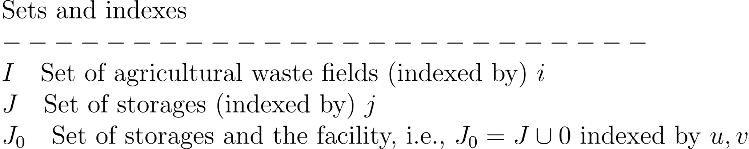
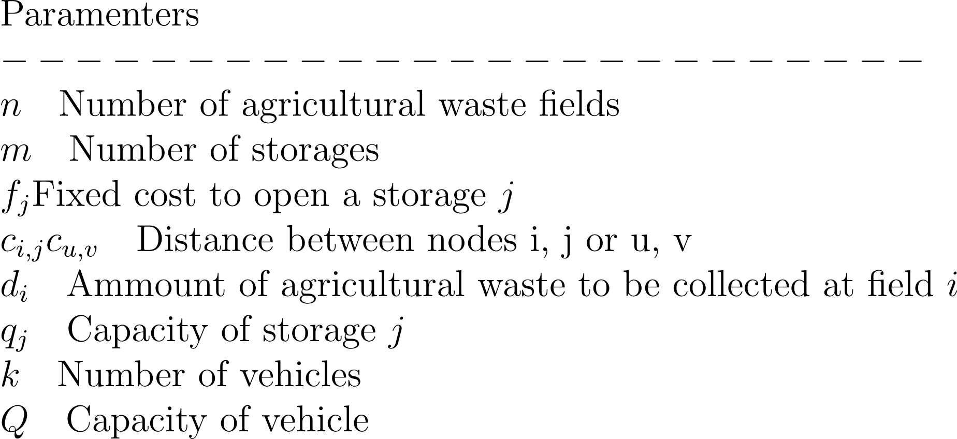
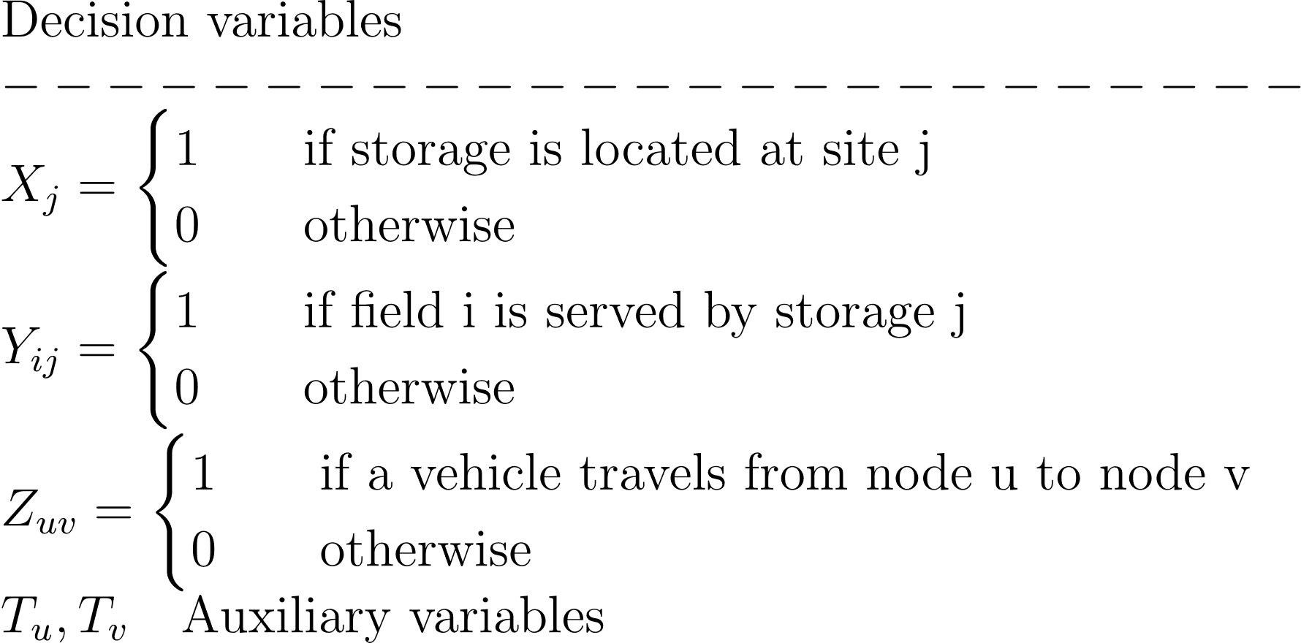
Model Formulation

Slide 11
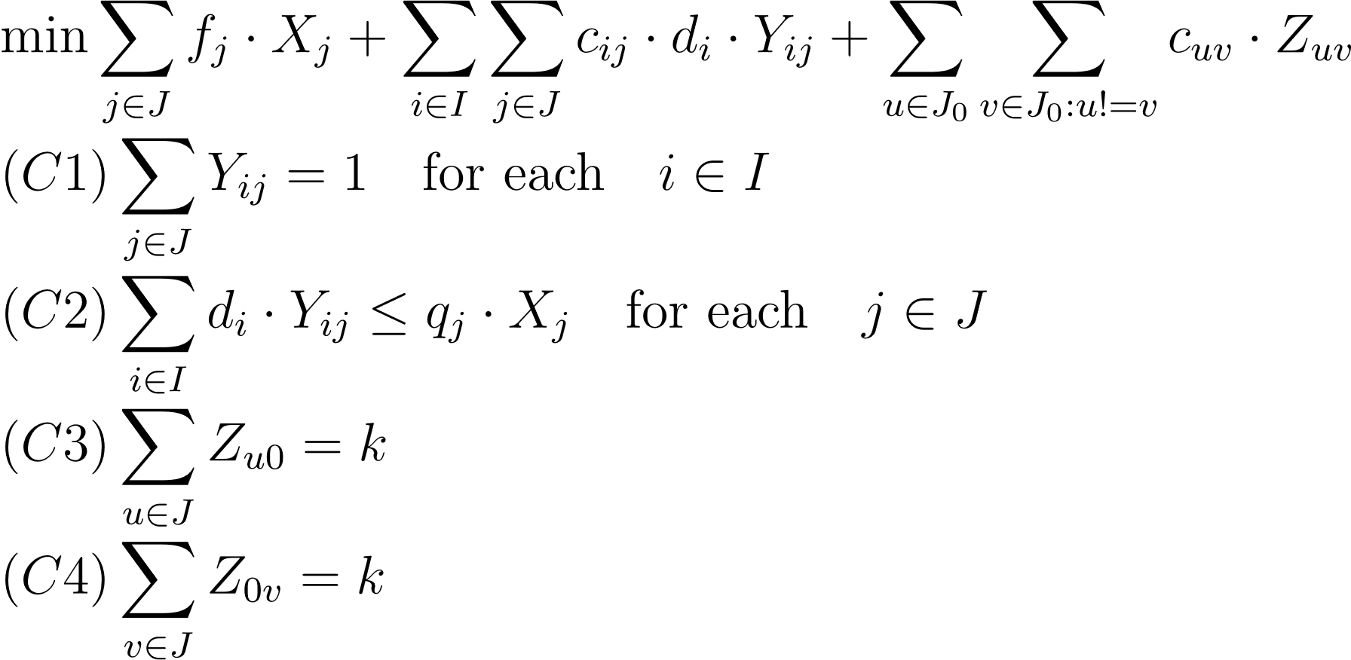
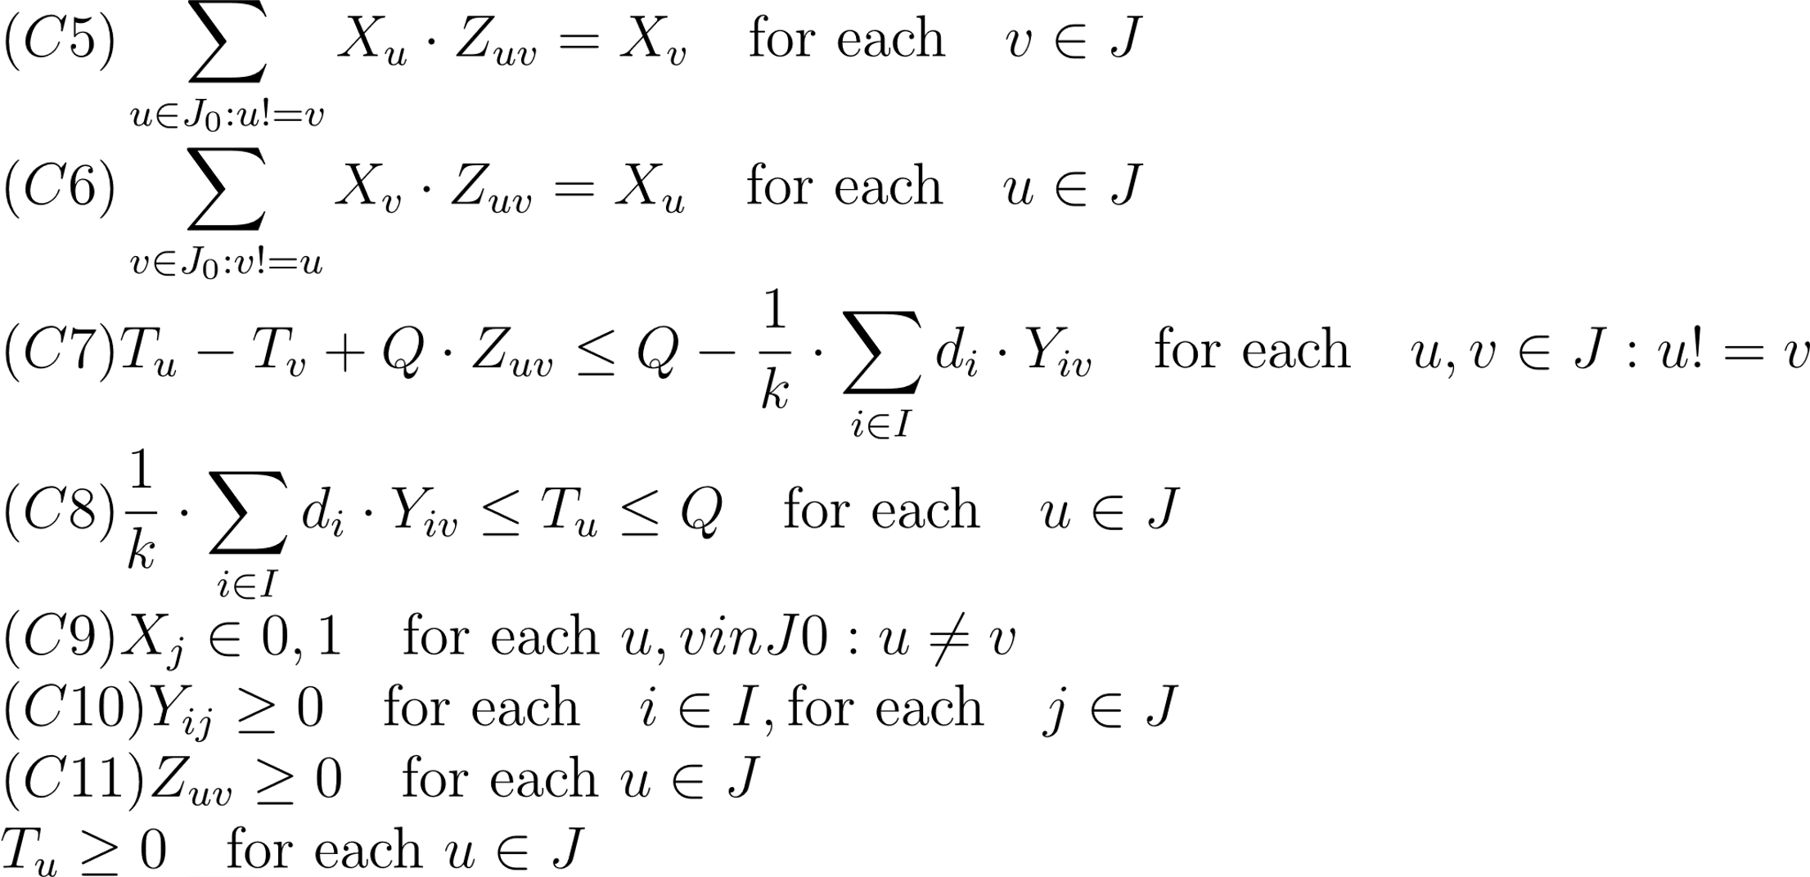
Model Formulation
Legenda
Capacitated facility location cstrs.
TSP adjusted for CVRP cstrs.
Assignment cstrs.

Slide 12
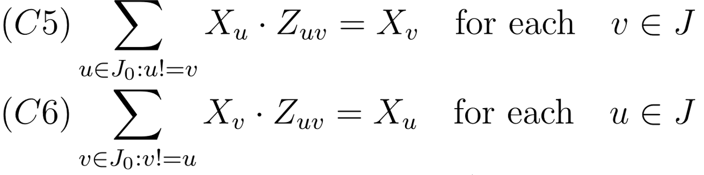
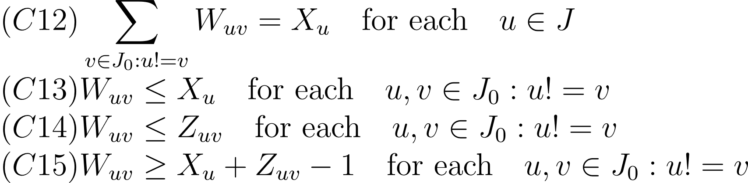
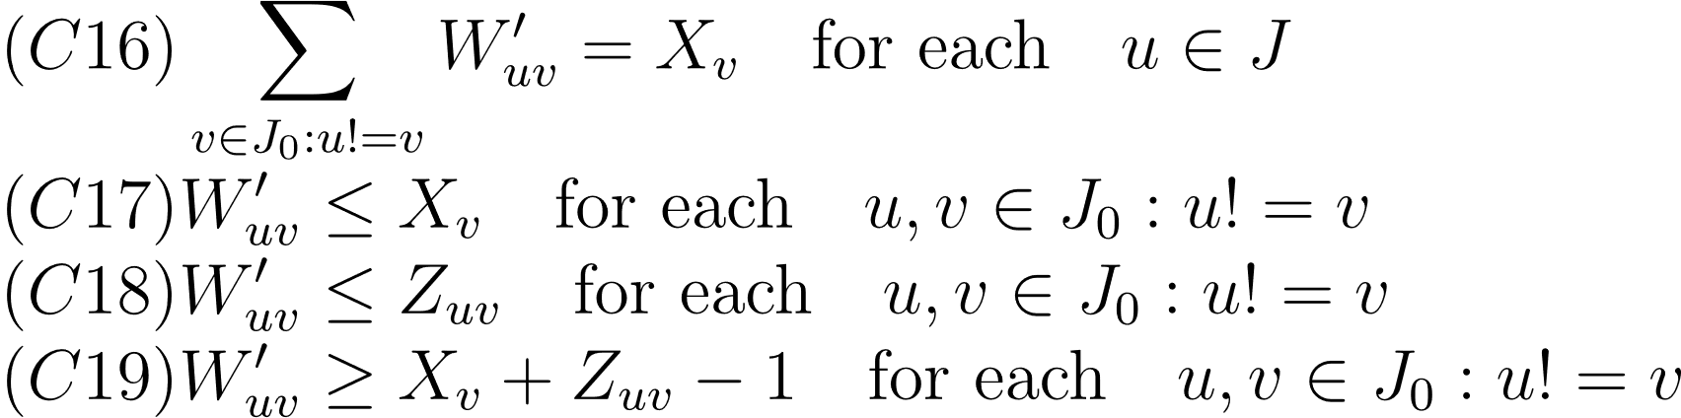
Model Formulation
Product of decision variables
Non-linear constrains
Linearization of non-linear constrains

Slide 13
03
Case studies & Scalability analysis
LARP optimal solution

Slide 14
Three scenarios for a proof-of-concept
X 3
Main facilities where bio-fertilizer is produced from the agricultural wastes (only one per scenario)
X 6
Storages with a certain capacity and fix opening cost
X 7
Cluster of agricultural fields with a certain amount of agricultural waste
X 3
Truks with a certain capacity and capable to move agricultural wastes from storages to the main facility

Slide 15
Graphical representations
All the scenarios share the same assignments among storages and agricultural fields
Storages «S3» and «S6» are not considered in the result, it means that opening a storage to these locations is not suggested
Location cost = 400
Assignment cost = 80,2

Slide 16
Graphical representations
scenario 1
scenario 2
scenario 3
Transportation cost = 57,0
Total cost = 537,2
Transportation cost = 119,2
Total cost = 599,4
Transportation cost = 55,0
Total cost = 535,2
R1 composed by: F1, S1, S4, F1
R2 composed by: F1, S2, F1
R3 composed by: F1, S5, F1
R1 composed by: F2, S1, S2, F2
R2 composed by: F2, S4, F2
R3 composed by: F2, S5, F2
R1 composed by: F3, S1, F3
R2 composed by: F3, S4, S2, F3
R3 composed by: F3, S5, F3

Slide 17
Scalability analysis
Parameters used for the experiment:
Num vehicles = 5
Vehicle capacity = 2000 (tons)
Facility = ‘F’
Num fields = [100, 500, 1000]
Num storages = [10, 20, 50, 100, 200]
Proposed model formulation is clearly not able to provide an optimal solution for different sizes of the problem, in «acceptable» timeframe.
Scalability plot confirms the NP-hard nature of the problem.

Slide 18
04
Water Flow Algorithm
A meta-heuristic improvement

Slide 19
References
Formulation and solution technique for agricultural waste collection and transport network design, European Journal of Operational Research
Waste Mismanagement in Developing Countries: A Review of Global Issues, International Journal of Environmental Research and Public Health
Statistics Report (2019), Ministry of Agriculture and Rural Development of Vietnam
A Waterflow Algorithm for Optimization Problems (2011), Tran Trung Hieu

